Slide 1

Search methods for human-machine games
Members
Cáceres Díaz, Renzo (11200004)
Escobar Villa, Andrés (6200075)
Gonzales Aburto, Ricardo (18200061)
Huamaní Avendaño, Dulce (18200219)
Molina Yupanqui, Flor (18200164)
Palomino Loa, Junior (18200172)
Quispe Vega, Anthony (18200179)
Vera León, Bryan (18200124)
Group 3

Slide 2
TABLE OF CONTENTS
01
02
BLIND OR UNINFORMED SEARCH
INFORMED SEARCH
First the best, A*, optimal
Breadth, depth

Slide 3
01
BLIND OR UNINFORMED SEARCH
Breadth, depth

Slide 4
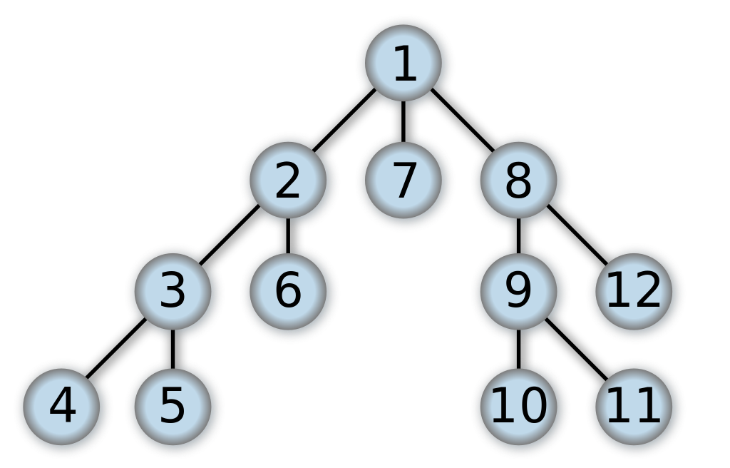
IN-DEPTH SEARCH
A Deep Search is an uninformed search algorithm used to traverse all the nodes of a graph or tree (graph theory) in an orderly, but not uniform, manner. Its operation consists of expanding each and every one of the nodes that it locates, recurrently, in a specific path. When there are no more nodes to visit on that path, it returns (Backtracking), so that it repeats the same process with each of the brothers of the node already processed.

Slide 5
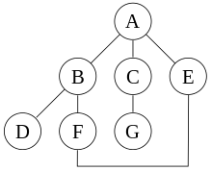
IN-DEPTH SEARCH EXAMPLE
Start deep search starting at node A, with the assumption that the edges on the left are chosen before the edges on the right, the algorithm will visit the nodes in this order: A, B, D, F, E, C, G. It can be noted that if the algorithm does not remember the nodes already visited, the algorithm could continue in an infinite turn A, B, D, F, E, A, B, D, F, E, etc. without visiting C or G.

Slide 6
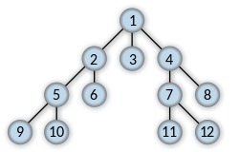
SEARCH IN WIDTH
Width search is an uninformed search algorithm used to traverse or search for elements in a graph (frequently used on trees). Intuitively, you start at the root (choosing some node as the root element in the case of a graph) and explore all the neighbors of this node. Then for each of the neighbors their respective adjacent neighbors are explored, and so on until the whole tree is traversed.

Slide 7
02
INFORMED SEARCH
First the best, A*, optimal

Slide 8
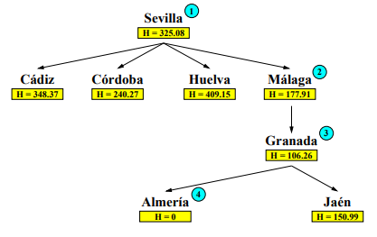
SEARCH FIRST FOR THE BEST
• Preferably analyze nodes with lower heuristics. • Sort the open queue by heuristic, from lowest to highest • Because you always choose to expand what you think is "closest" to the goal • Its performance will depend on the goodness of the heuristics used.

Slide 9
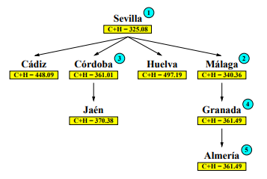
SEARCH A*
Objective of the A∗ search • achieve good (optimal) solutions. • gain in efficiency (reducing the search tree). Idea: assign each node n a value f(n) = g(n) + h(n) • g(n): cost of the road to n • h(n): node heuristics, estimating the cost of an optimal path from n to a final state • f(n): estimation of the total cost of an optimal solution passing through n Always select the node with the lowest f value • ordering the OPEN queue in increasing order with respect to f

Slide 10
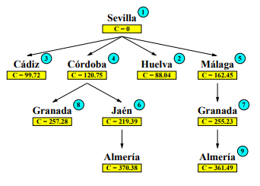
OPTIMAL SEARCH
Analyze the nodes with the lowest cost first. That is, sort the queue of open by cost, from lowest to highest In this way, when you first arrive at a state, you arrive at the lowest possible cost. - And in, the first time we reach a final state we have an optimal solution This is a blind or uninformed search: - Does not use knowledge to guide the search towards the goal

